Slide 1
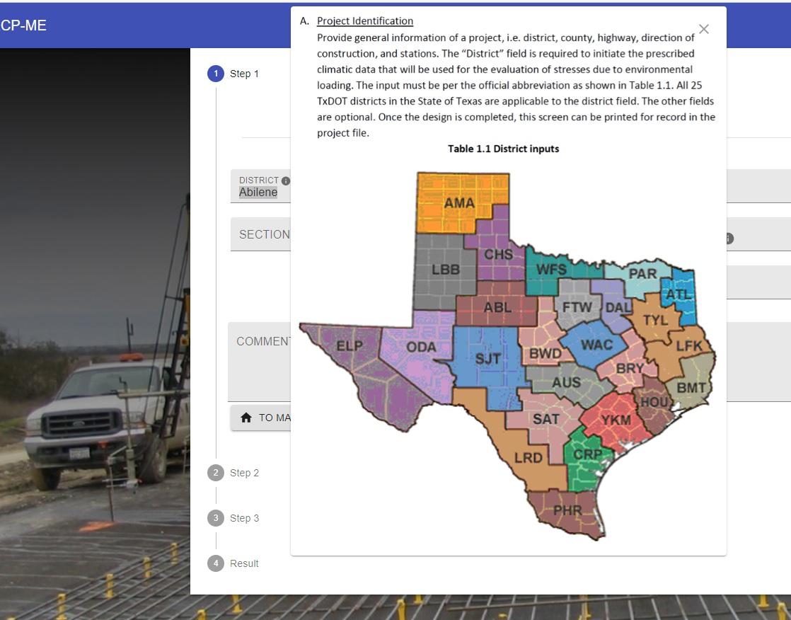
2. No function to select district from the map

Slide 2
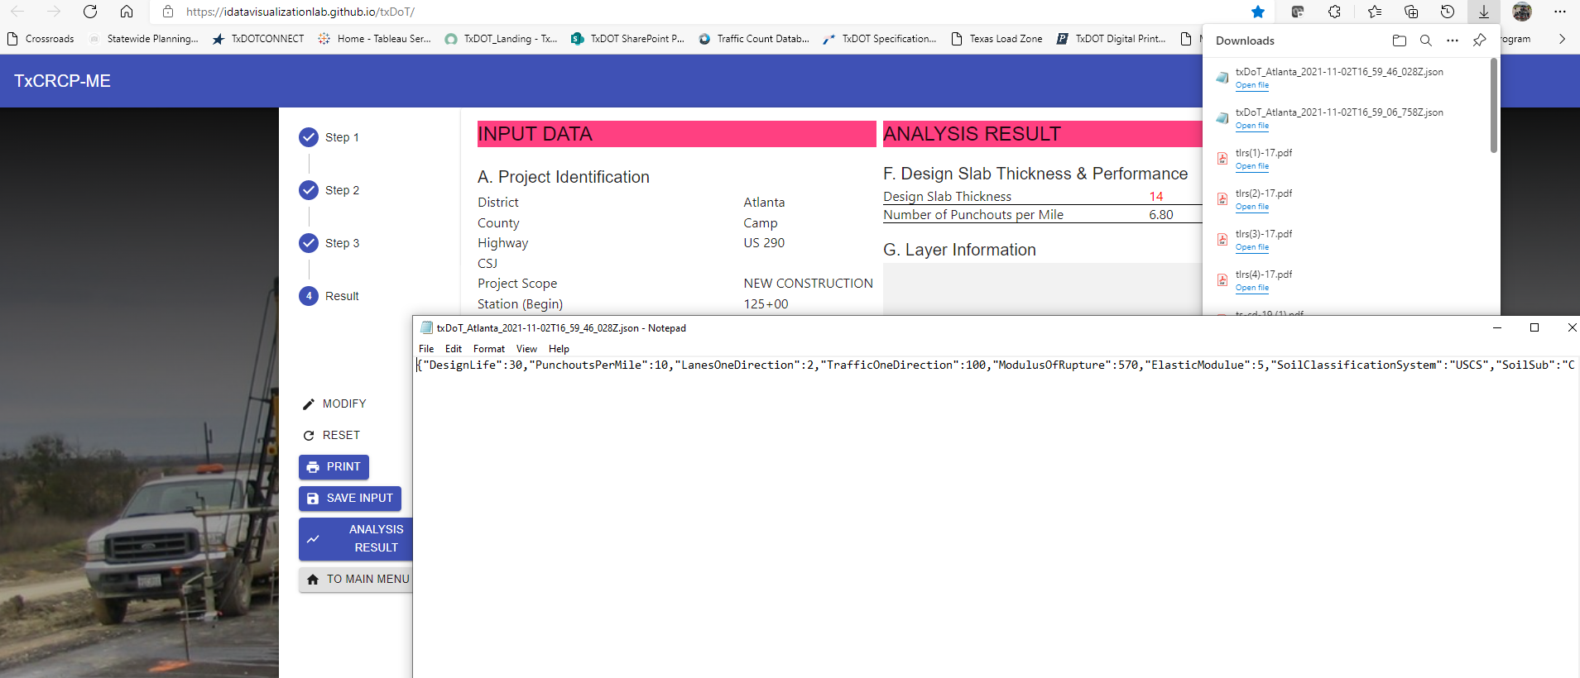
11. Save Input
The designers should be able to see their results sheet from the saved file.

Slide 3
TxCRCP-ME Interface Review
11/02/2021

Slide 4
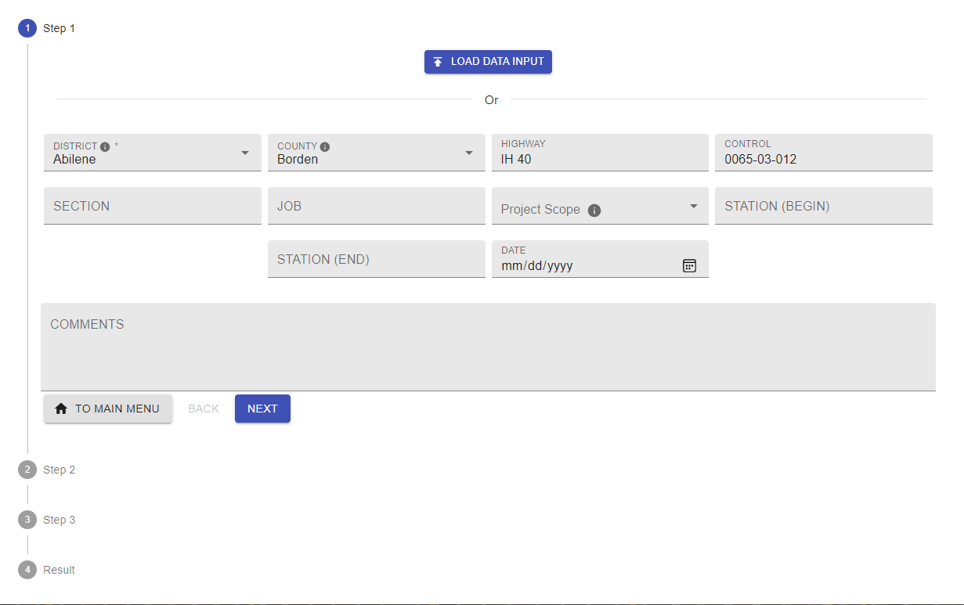
1. Box Position

Slide 5
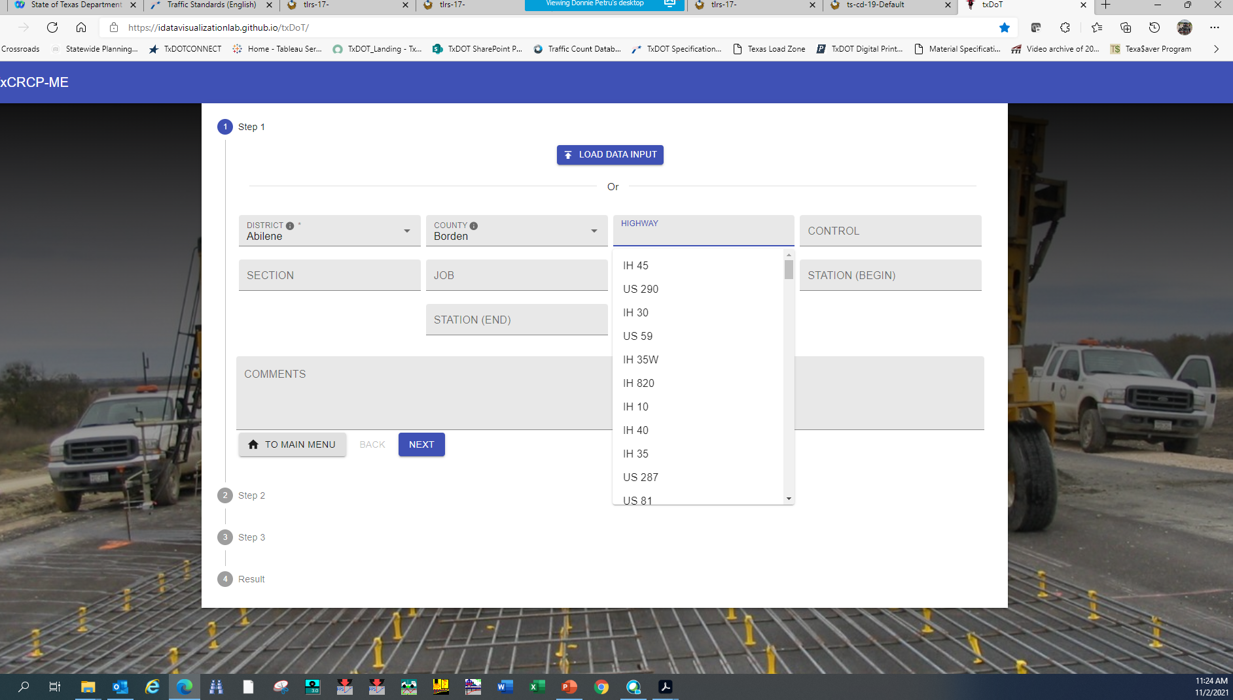
3. Still shows highways

Slide 6
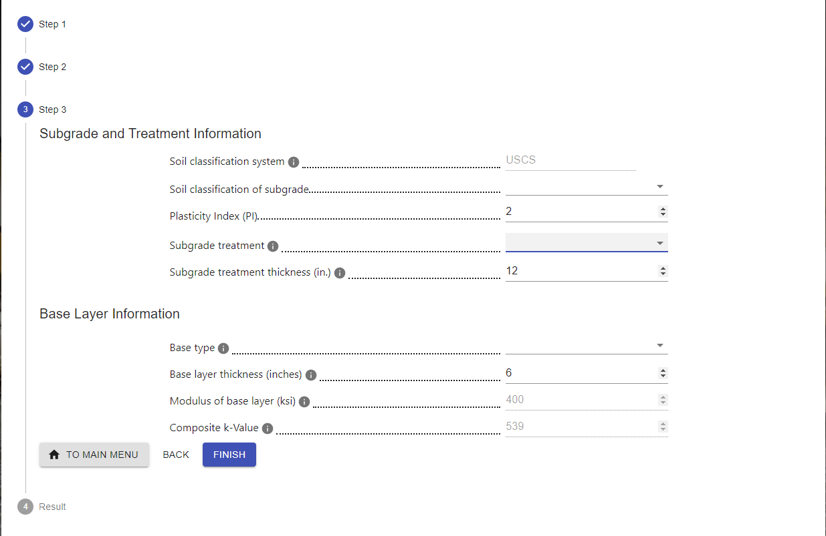
8. Subgrade Treatment
Dropdown menu
Cement treated subgrade
Lime treated subgrade
Lime-cement treated subgrade
Lime-fly ash treated subgrade
Fly ash treated subgrade
Select Fill
User Input (such as compacted existing roadbed)
No change with respect to PI change (remove logic)

Slide 7
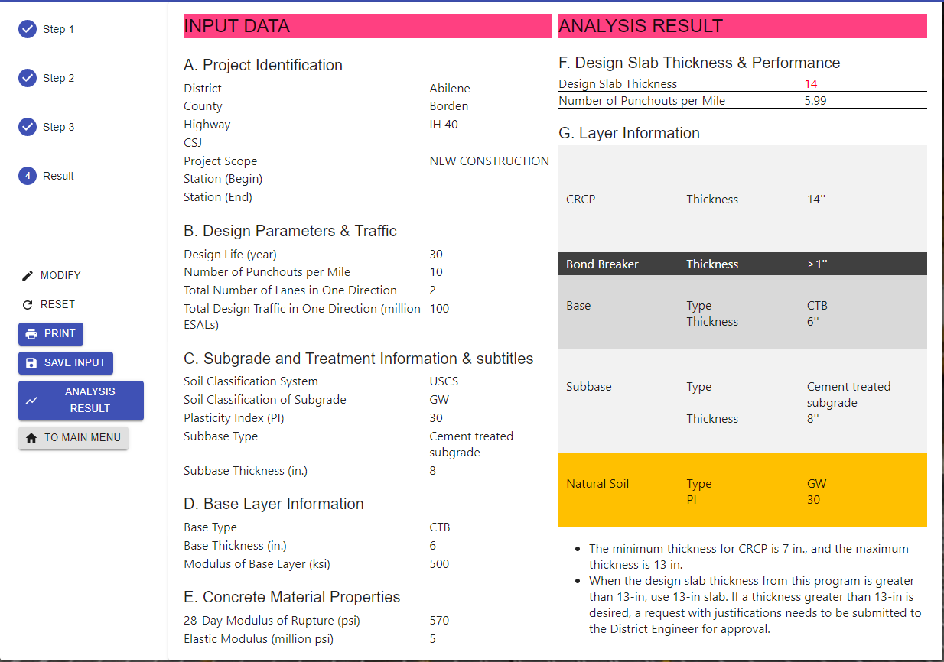
9.
No info
*No back icon
Subgrade

Slide 8
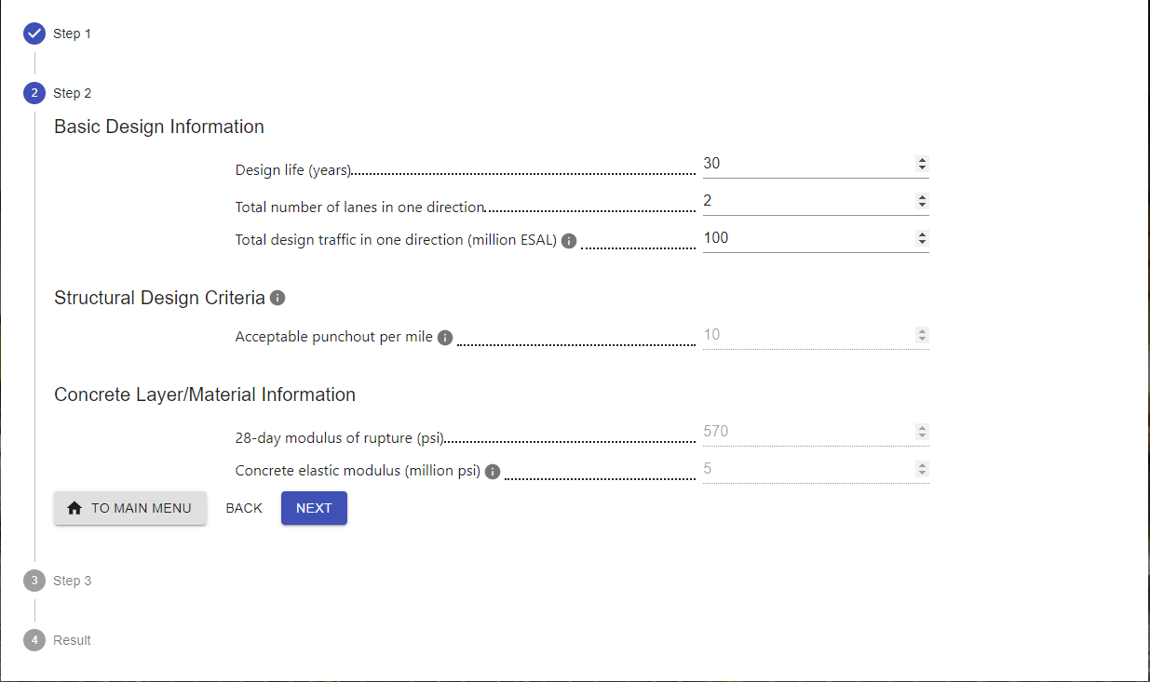
4. Should be blank

Slide 9
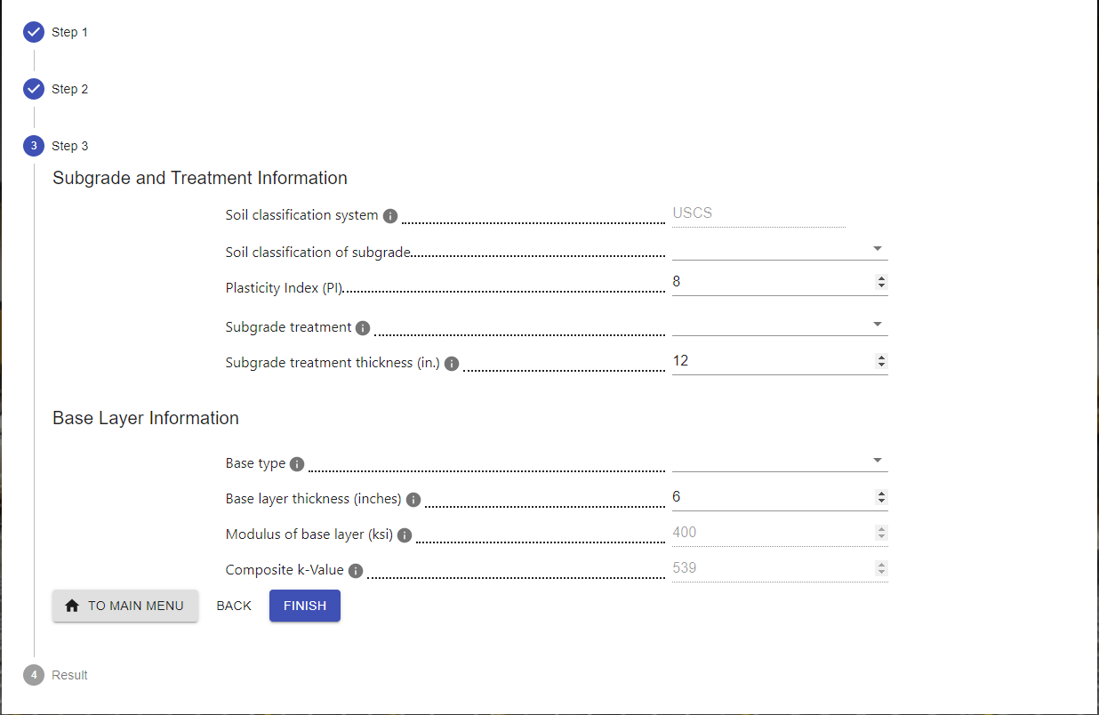
5. Should be a blank

Slide 10
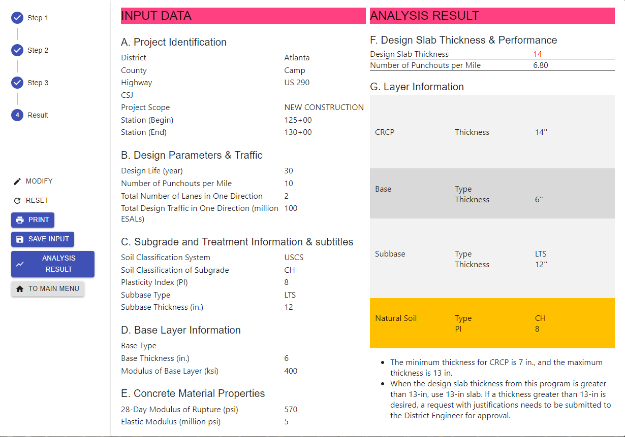
7. Program still works without having any inputs
Error messages should be popped up if the designer does not input the data.

Slide 11
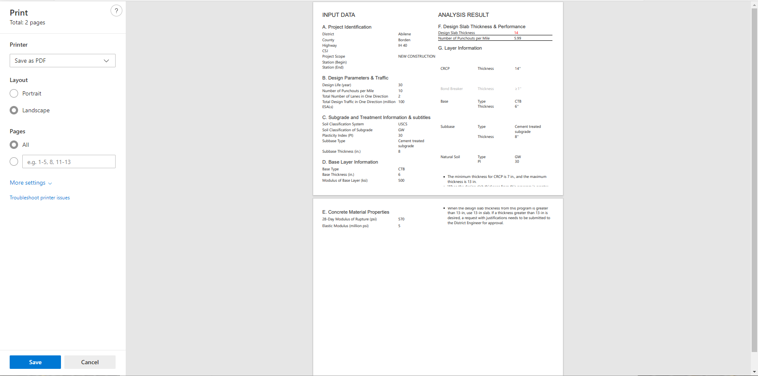
10. Print – 2 pages
Should be 1 page – no color for base, subgrade, …

